Slide 1


Extraordinary Service in Your Shop Every Day: PFW
presented by Tim Huckabee FSC President of FloralStrategies

Slide 2





Phone
Floor
Website

Slide 3

Customer Service is the NEW Design

Slide 4


Slide 5
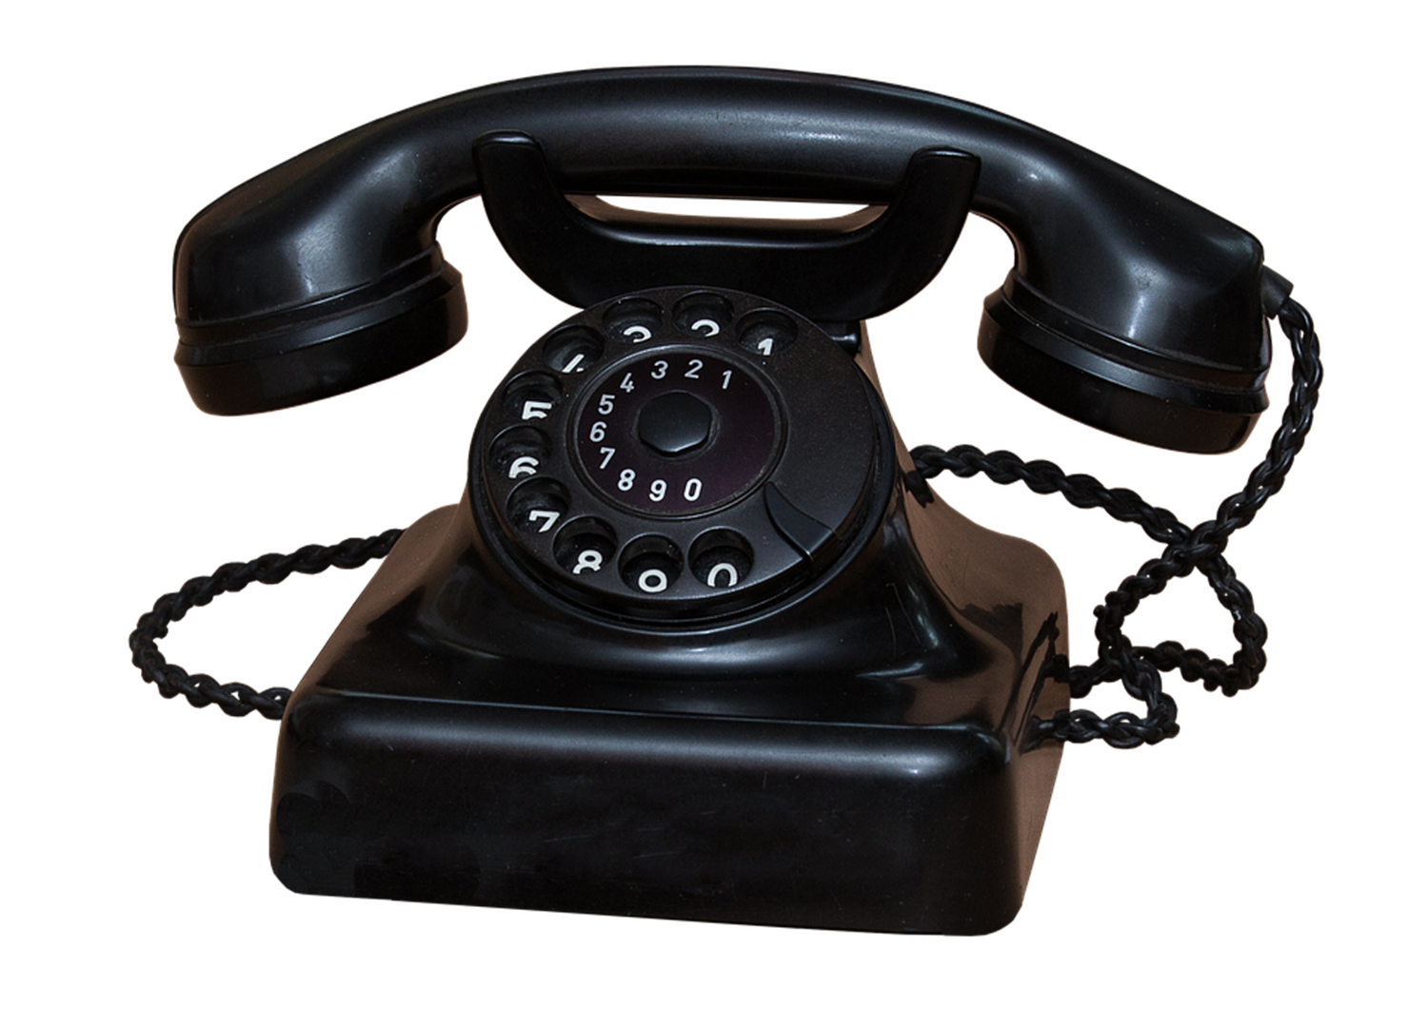

Slide 6



Slide 7



Slide 8



Slide 9



Slide 10



Slide 11
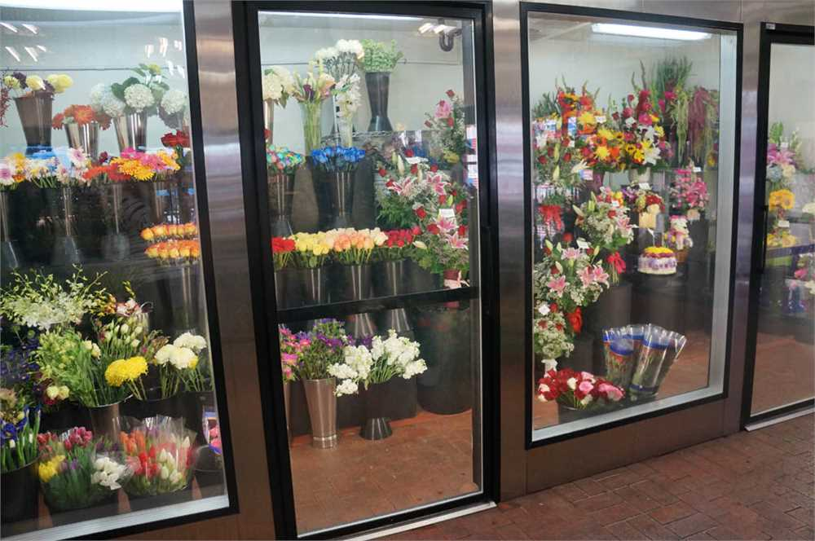

Slide 12


Slide 13


Slide 14


Slide 15


Slide 16


Slide 17


Slide 18


Slide 19
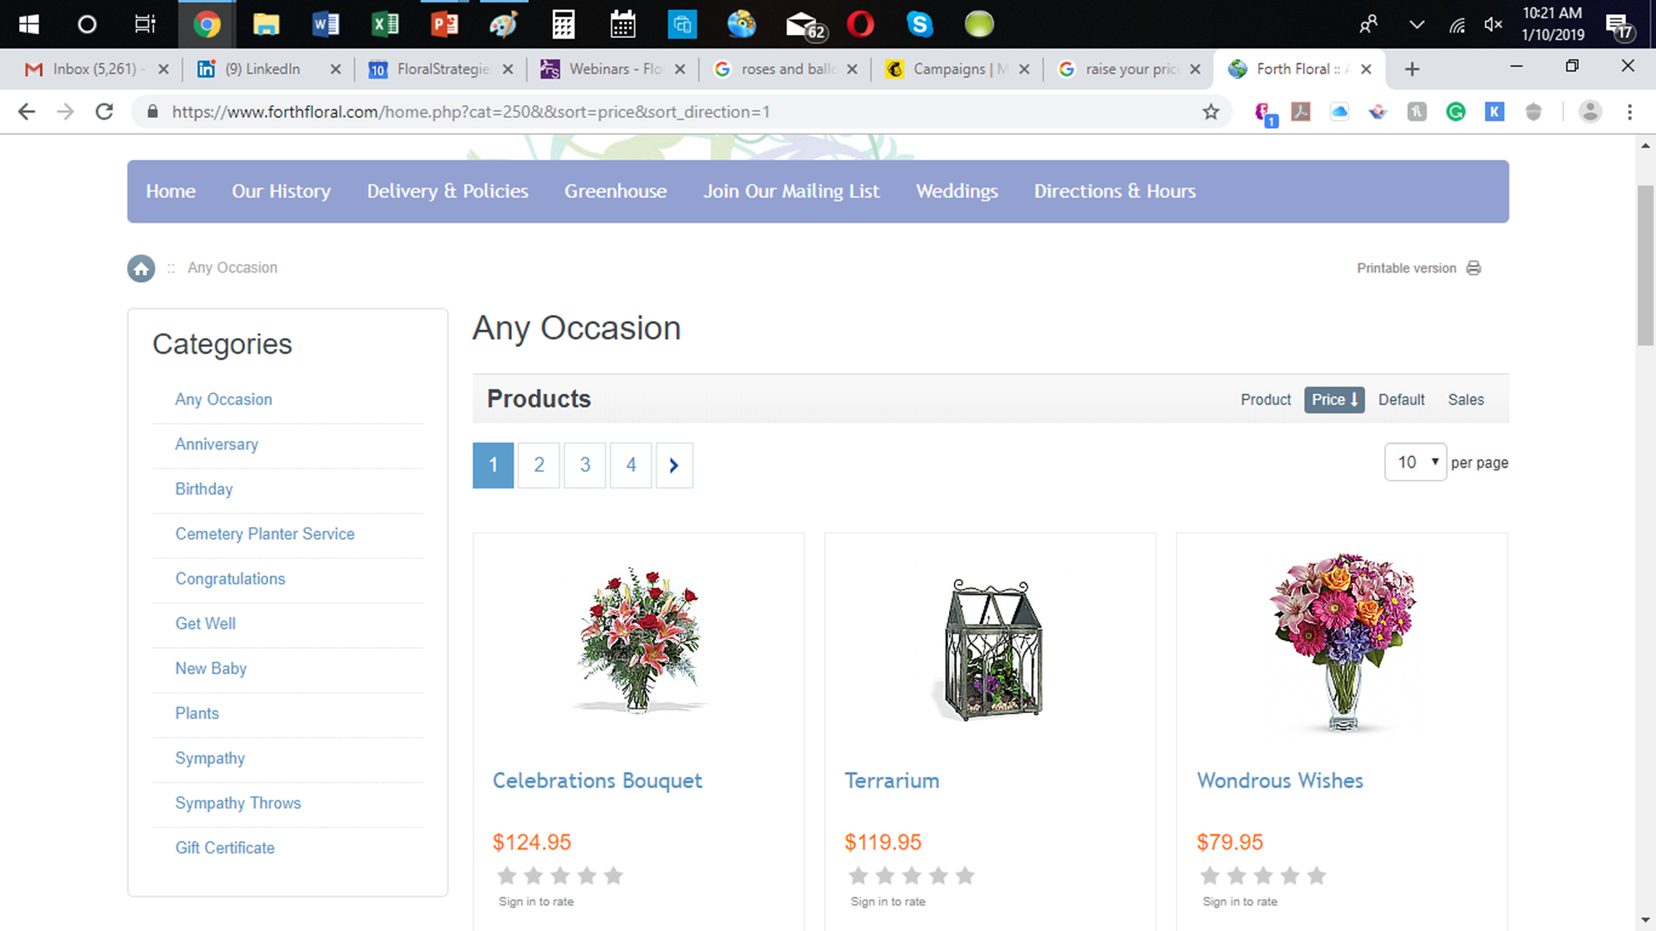
OFFER HIGHER PRICES

Slide 20

SOLICIT PREORDERS ONLINE AND IN SOCIAL MEDIA

Slide 21
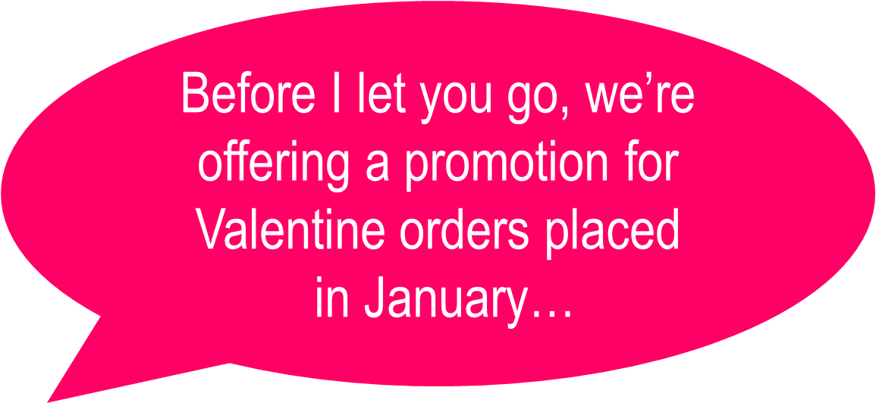

Slide 22

KEEP YOUR SITE CURRENT!

Slide 23

LIMIT CUSTOMER CHOICES

Slide 24


Slide 25

Email NASHVILLE to tim@floralstrategies.com for a copy of this handout
Come talk to me at the Floristware booth about exciting new educational opportunities for YOUR staff!

Slide 26


Slide 27


